Slide 1


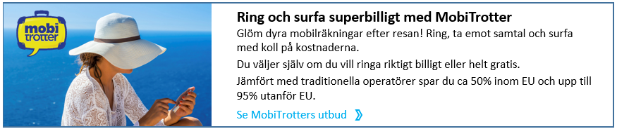
MobiTrotter
Roaming free calls worldwide
MobiTrotter in brief
MobiTrotter is a new mobile app for Android and iPhone providing roaming-free mobile telephony for leisure travellers.
The app saves up to 95% on all international calls and enables mobile surf abroad with 90-99% savings.
MobiTrotter can be used on WiFi or with a local sim card. Either way you keep your regular number.
MobiTrotter has a unique market position being one single provider for all international call cases.
Free WiFI-WIFi calls trigger the customers to download the app. It fits well with the trend of Tour Operators expanding their WiFi-networks.
The main sales channel is via partners in the Travel Industry. MobiTrotter is a perfect value added service for the Travel Industry. The offering is a win-win due to commission based revenues for the partners and big savings for their customers.
The company, based in Stockholm, Sweden, is in the start-up phase and has up until today secured visibility to ~ 1.000.000 travellers.
First partners
Ving Sweden, part of Thomas Cook Group: 660.000 travellers Sweden, ~1,5 million travellers in Scandinavia
Apollo Sweden, part of Kuoni Group: 350 000 travellers Sweden, ~1 million travellers in Scandinavia
Market
Total addressable market;
Phase 1; the Nordic countries: 5,4 million travellers
Smartphone penetration is increasing, ~60% in our target group.
Go to market strategy
Establish partnerships within the travel industry
100% same target group
Great exposure scheduled before travel e.g. pre-departure emails, ads on boarding cards and ads as text messages.
International footprint opens up multiple markets with each agreement.
2. Fast international roll out:
Phase 1: Establish presence in Europe, Asia and Australia, completed spring 2015.
Phase 2: Expansion in Europe and Asia +
Australia, completed by end of 2016.
LNC global mobile is technically prepared to roll out in +50 countries.
Exampel exposure
Pre-departure email from tour operators/travel agencies
For further information please contact
Peter Hellman, Board member/Senior advisor LNC global mobile AB/ MobiTrotter,
Mobile: +46709503878, peter.hellman@gmail.com
LNC global mobile AB
www.mobitrotter.com
Partihandlarvägen 47
120 44 Årsta, Sweden

